Slide 1

Secure and Reliable WSN for Internet of Things
Vinit K

Slide 2
Abstract
Wireless Sensor Network (WSN) is an innovative technology with a broad range of applications and highly attractive
The by using communication technologies in sensors and sensing features in web devices, WSNs have begun interaction with the IOT devices.
The analysis of security threats against WSN and IOT, along with the strategies for preventing, detecting and mitigating those threats.
The aim is to address and demonstrate the impact of the security problems on WSNs from the viewpoint of the IOT and its applications.
This defence mechanisms can help in building a safe and Secured IOT applications.

Slide 3
Contents
INTRODUCTION
WSN AND IOT ARCHITECTURE
CHALLENGES TO OVERCOME SECURITY ISSUES
POSSIBLE ATTACK AND THREATS TOWARDS THE WSNS AND IOT
SOLUTION FOR SAFE IOT
CONCLUSION
REFERENCES

Slide 4
Introduction
Wireless Sensor Networks (WSNs) are one of the major technologies required for the implementation of Internet of Things (IOT) architecture.
IOT is emerging as a dynamic cyber-physical network that is enabling smart devices to sense and change the world. Further it will assist the humanity in functioning and living.
WSNs have started to merge with the Internet of Things (IOT) through the introduction of Internet access capability in sensor nodes and sensing ability in Internet-connected devices.
The presence of large network of interconnected objects leads to serious issues about security that restricts the wider use of IOT.

Slide 5
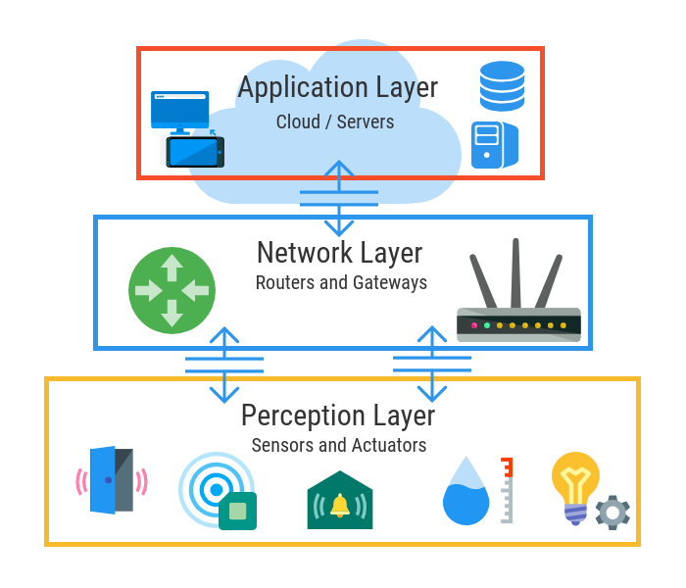
WSN AND IOT ARCHITECTURE
The IOT architecture has three layers (perception layer, network layer, and application layer).
Perception layer – Sensors, actuators and edge devices that interact with the environment
Network Layer – Discovers, connects and translates devices over a network and in coordination with the application layer
Application Layer – Data processing and storage with specialized services and functionality for users

Slide 6
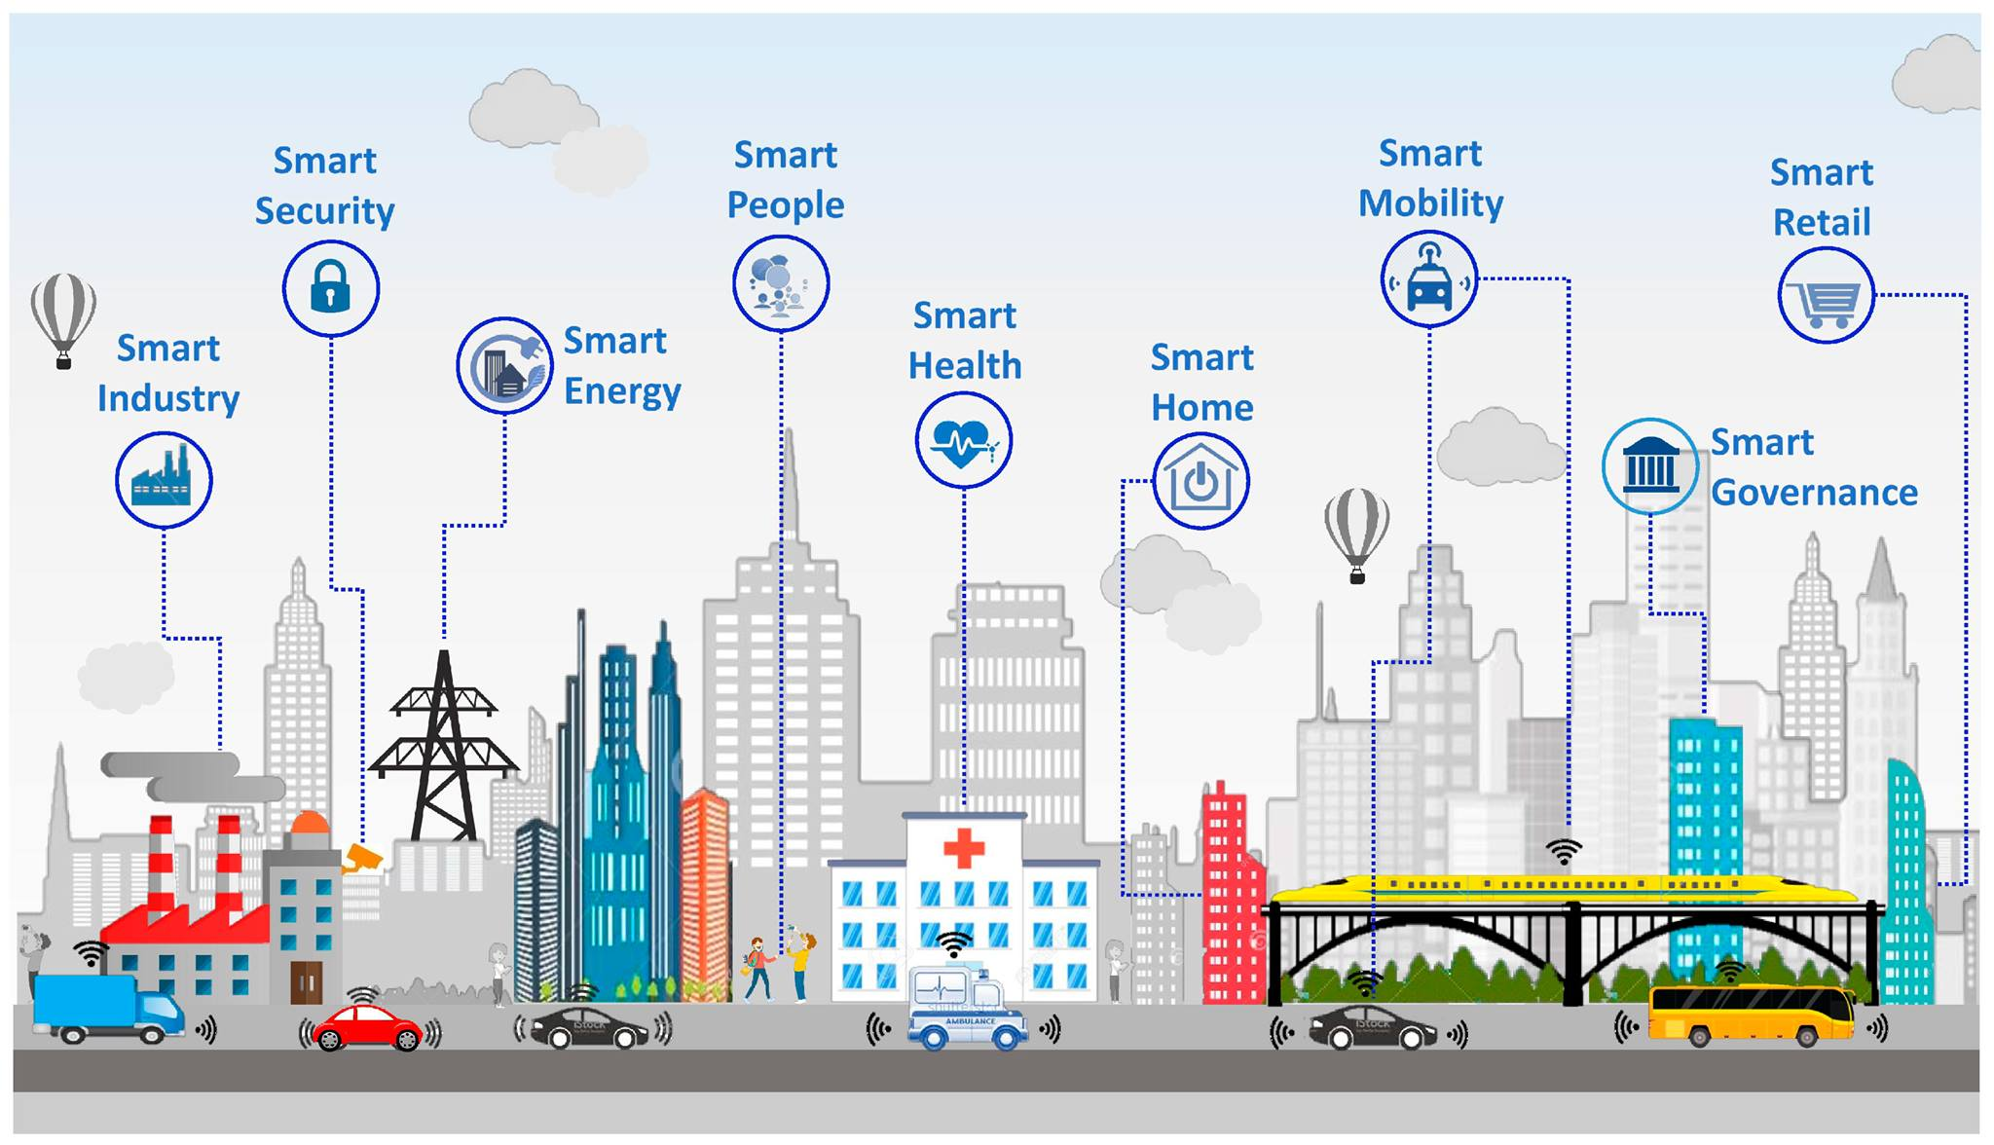
IOT WORLD

Slide 7
CHALLENGES TO OVERCOME SECURITY ISSUES
Security
Data Privacy
IOT Components
Quality of Service
Configuration
Fault Tolerance
Scalability
Timing of Data Delivery
Energy Consumption
Gathering Data

Slide 8
ATTACK AND THREATS TOWARDS THE WSNS AND IoT
The Perception Layer
Eavesdropping
Node Capture
Fake Node and Malicious
Replay Attack
Timing Attack
The Network Layer
Denial of Service Attack
Main-in-The-Middle Attack
Storage Attack
Exploit Attack
The Application Layer
Cross-Site Scripting
Malicious Code Attack

Slide 9
Solution for Secure iot
List Improve On Outdated Hardware And Software
Improve On Weak And Default Credentials
Improve On Protection Against Malware And Ransomware
Preventing Predictable Attacks
Encrypt user and application data

Slide 10
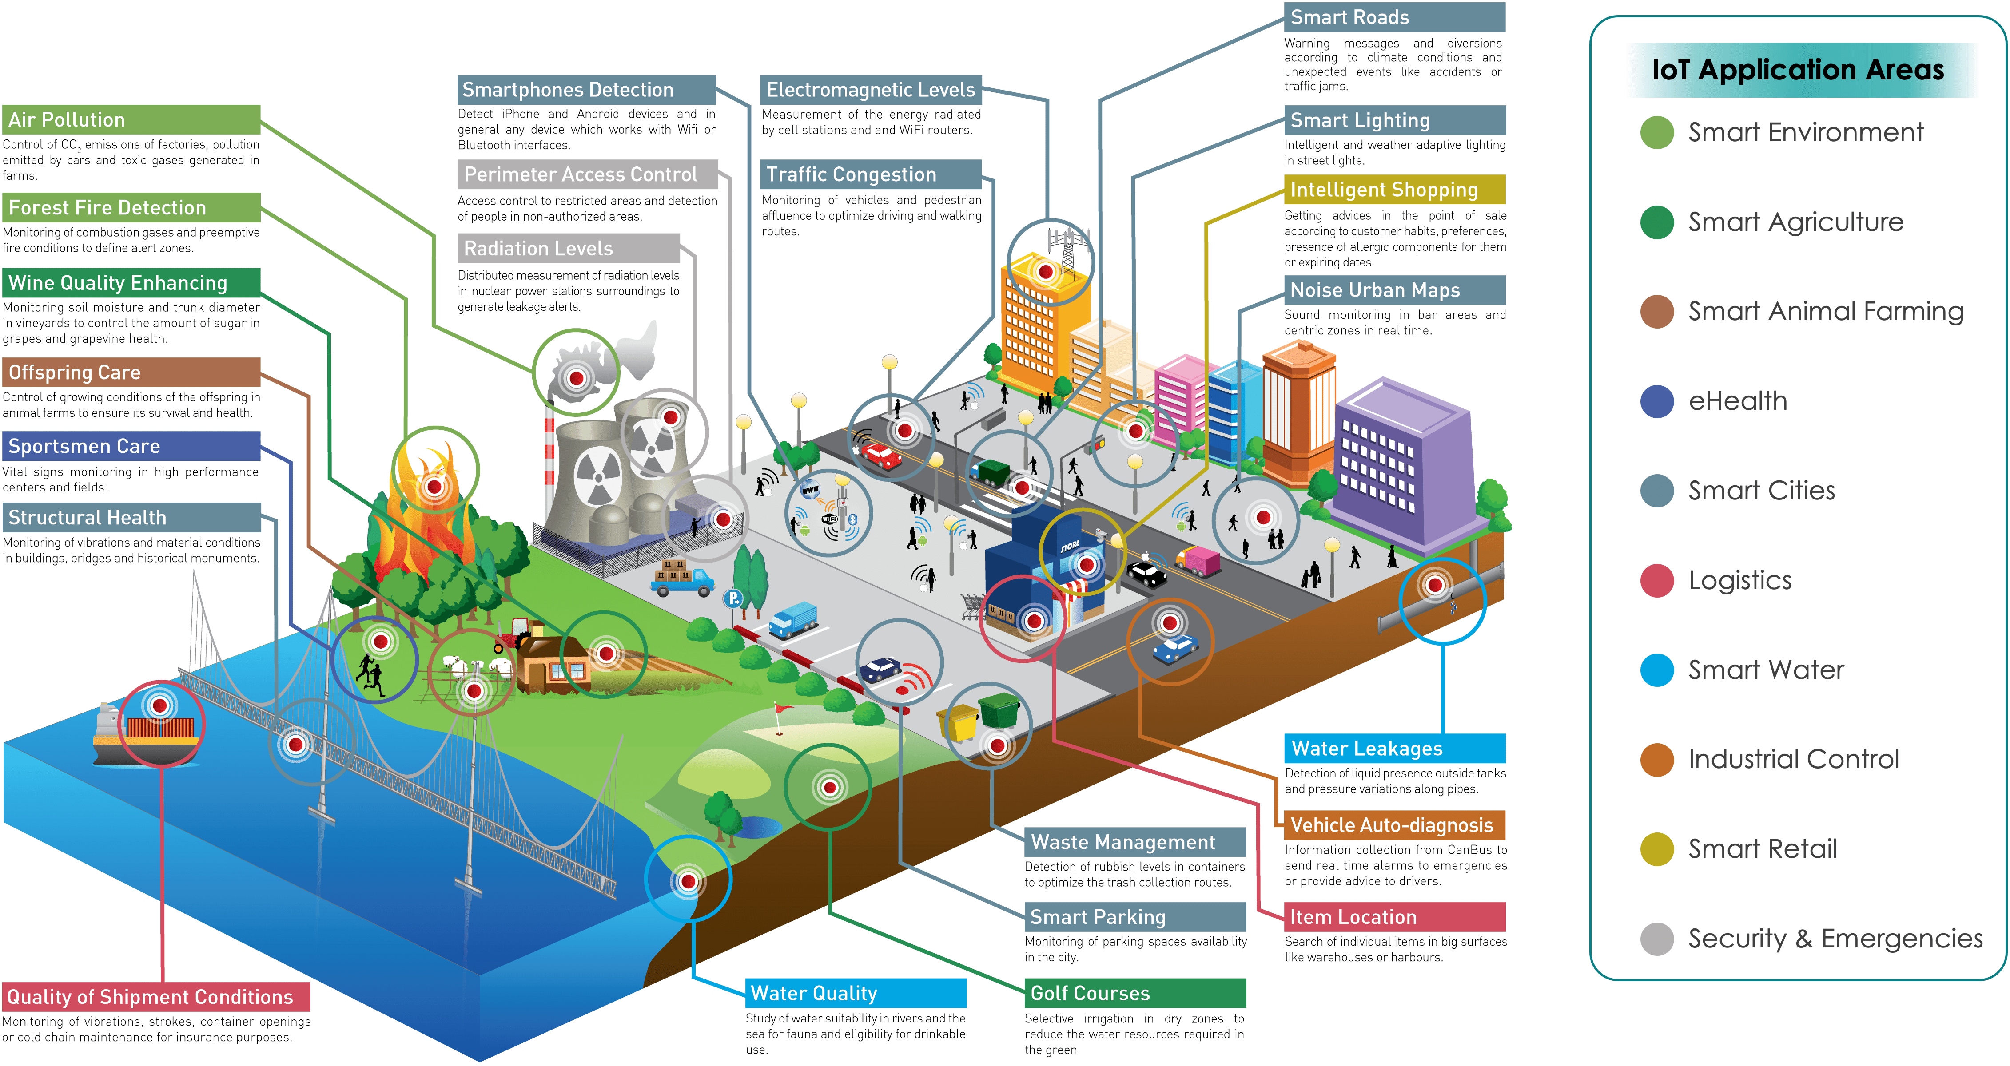
iot application

Slide 11
CONCLUSION
The Internet of Things (IOT) is quickly weaving itself into modern life all around the world. By connecting smart devices, applications, and other technology, it has the power to enhance quality of life and automate a near-infinite number of interactions.
Still, we hope this brief overview has properly outlined how layered architectures of IOT can be subject to specific, malicious attacks by third parties.
the possibilities of the IOT are indeed exciting, proper precautions and security measures must be taken at all times.
Moreover, it is important to consider new multi-layered architectures in order to design a more secure infrastructure for the IOT.

Slide 12
REFERENCES
[1] N. Salman, I. Rasool, and A. H. Kemp, ‘‘Overview of the IEEE 802.15.4 standards family for low rate wireless personal area networks,’’ in Proc. 7th Int. Symp. Wireless Commun. Syst., Sep. 2010, pp. 701–705, doi: 10.1109/ISWCS.2010.5624516.
[2] J. Lin, W. Yu, N. Zhang, X. Yang, H. Zhang, and W. Zhao, ‘‘A survey on Internet of Things: Architecture, enabling technologies, security and privacy, and applications,’’ IEEE Internet Things J., vol. 4, no. 5, pp. 1125–1142, Oct. 2017.

Slide 13


